Slide 1
LinkedIn Fake Profile Detection in the Era of LLM-Polished Text

Slide 2
Motivation
Motivation: Detecting LLM-Enhanced Fake Profiles on LinkedIn
LinkedIn is increasingly LLM-mediated: Users now routinely use large language models to polish, rewrite, or fabricate professional profiles.
Authenticity is no longer binary: Profiles exist on a spectrum—from fully human-written to fully LLM-generated, with many hybrid cases in between.
Security and trust implications: Fake or deceptive profiles enable scams, impersonation, hiring fraud, and misinformation at scale.

Slide 3
Motivation
Limitations in Existing Work (Gulati et al.)
Limited treatment of hybrid authorship: LLM-polished human profiles remain difficult to distinguish from genuinely well-written human profiles.
“AI polishing” is acknowledged but not deeply resolved as a standalone class.
Binary or coarse-grained classification: Existing benchmarks largely emphasize real vs fake, which does not reflect real-world LinkedIn usage.
Lack of intent-aware categorization: Human-written but deceptive profiles (crafted for fraud or impersonation) are underexplored.

Slide 4
Problem Statement
LLMs are increasingly used on LinkedIn to rewrite summaries, enhance experience descriptions, and polish professional language. This blurs the boundary between authentic self-presentation and AI-mediated or deceptive profiles.
Existing detection methods largely assume binary authorship (human vs. machine), which does not reflect real-world usage. Hybrid profiles—human-written but LLM-polished—are common yet poorly modeled.
Human-generated fake profiles (crafted for impersonation or fraud) are often conflated with LLM-generated content. There is no unified framework to jointly model: Degree of LLM involvement, Authenticity vs. deception intent
This motivates a four-way classification formulation or fine-grained framework for :
Real
GPT-generated
Human-written but LLM-polished (GenuineGPT)
Human-written deceptive profiles

Slide 5
Dataset Overview
Structured CSV containing 81k individual LinkedIn user profiles
Includes demographic details, location, and connection/follower metrics
Captures professional experience, education history, certifications, and skills
Records platform activity such as projects, publications, interests, and organizations
Profiles are real or fake (unlikely to be GPT-Fake as the dataset is from 2022), but still possible - 2 or 3 classes
Contains aggregate counts for each profile section and an associated label for analysis

Slide 6
Genuine GPT Profile Generation
Real LinkedIn profiles from the dataset are used as the base source of content
Profiles are rewritten using GPT to produce polished, fluent, and professionally enhanced versions
Semantic content (roles, skills, timelines) is preserved while improving coherence and tone
The resulting profiles, termed “Genuine GPT”, mimic realistic human profiles with LLM-style refinement

Slide 7
Experimental Setup for Baseline Metrics
Follows the experimental pipeline of LLM-DetectAIve (main) for consistency and comparability
Profile text fields are preprocessed and formatted as model inputs
DistilBERT is used as a lightweight transformer to establish baseline classification performance
Evaluation:
Metrics: Accuracy, Precision, Recall, F1-score (weighted average)
Final evaluation on held-out test set with classification report

Slide 8
Experimental Setup for Baseline Metrics - LLM DetectAIve Pipeline
Phase 1: Data Preparation (dataset_csv.py)
1.1 Data Loading (read_csv): Reads a CSV file into a pandas DataFrame.
1.2 Data Parsing (csv_dataset_parser)
Text concatenation: Combines multiple columns (Intro, Full Name, Workplace, Location, About, Experiences, Educations, etc.) into a single text field.
Label mapping: Maps original labels to 0-3:
0 → 0 (Human-Written)
1 → 1 (Human-Written, Machine-Polished)
10 → 2 (Machine-Generated)
11 → 2 (Machine-Generated)
1.3 Dataset Splitting (prepare_dataset)
Stratified train/val/test split: 70% / 15% / 15% (preserves label distribution).
Conversion: Converts pandas DataFrames to Hugging Face DatasetDict with train, val, and test splits.

Slide 9
Experimental Setup for Baseline Metrics - Pipeline
Phase 2: Model & Tokenization Setup (model_pipeline.py)
2.1 Model Loading (get_model_and_tokenizer)
Loads a pre-trained model from Hugging Face (e.g., distilbert-base-uncased, roberta-base).
Loads the corresponding tokenizer.
Initializes AutoModelForSequenceClassification with num_labels=4.
2.2 Tokenization (tokenize_and_prepare_dataset)
Tokenizes text: Converts text to token IDs using the model's tokenizer.
Padding/Truncation: max_length=256, padding='max_length', truncation=True.
Format conversion: Removes original text/domain columns, sets format to PyTorch tensors.
Result: Dataset with input_ids, attention_mask, and labels.

Slide 10
Experimental Setup for Baseline Metrics - Pipeline
Phase 3: Hyperparameter Optimization (train_model → objective)
3.1 Optuna Study Setup
Creates an Optuna study to maximize F1 score.
Default: 5 trials.
3.2 Trial Objective Function (objective)
For each trial:
Hyperparameter sampling:
Learning rate: 1e-6 to 1e-4 (log scale)
Weight decay: 1e-7 to 1e-1 (log scale)
Epochs: 1 to max_epochs (default 5)
Training configuration:
Batch sizes: train=16, eval=64
Evaluation: every epoch
Model saving: after each epoch
Best model: loaded at the end (load_best_model_at_end=True)

Slide 11
Experimental Setup for Baseline Metrics - Pipeline
Phase 3: Hyperparameter Optimization (train_model → objective)
Training & evaluation:
Trains on the train set.
Evaluates on the validation set.
Returns validation F1 score.
3.3 Best Hyperparameters Selection
After all trials, selects the hyperparameters with the highest validation F1.

Slide 12
Experimental Setup for Baseline Metrics - Pipeline
Phase 4: Final Training (train_model)
After hyperparameter optimization:
Creates a new model instance.
Uses the best hyperparameters from Phase 3.
Training configuration:
Evaluation: every 500 steps (instead of every epoch)
Logging: every 500 steps
Saves checkpoints in ./results_{model_name}/
Best model: selected based on validation performance

Slide 13
Experimental Setup for Baseline Metrics - Pipeline
Phase 5: Evaluation (evaluate_model)
Test set evaluation:
Uses the held-out test set (never seen during training/validation).
Computes predictions.
Metrics computed:
Accuracy
Precision (weighted)
Recall (weighted)
F1-score (weighted)
Output:
Prints test set metrics and detailed results.

Slide 14

distilbert-base-uncased
Distilbert-base-uncased: 1 hyperparameter tuning round with 3 epochs each:
Distilbert-base-uncased: 2 hyperparameter tuning rounds with 5 epochs each:

Slide 15
Other Existing Detectors for LLM-Generated Text
Existing detectors: GPTZero, ZeroGPT, and Sapling AI.. (All are Zero Shot)
None of these however support four classes. GPTZero is the only one that goes beyond binary classification: it adds a mixed text; however, it limits users to only 40 free runs per day or 10,000 words per month for registered accounts.

Slide 16
MixSet - ACL 2024
What is MIXSET?
MIXSET is the first dataset designed to study mixtext — text containing both human and AI contributions. It addresses real-world scenarios like AI-revised human writing (e.g., text polished or completed by LLMs) and human-edited AI writing (e.g., text adjusted or humanized by humans).
Why is it needed?
Existing Machine-Generated Text (MGT) detectors mostly handle pure AI or human text, failing in mixed cases common in journalism, academia, and education. MIXSET fills this gap by simulating realistic hybrid writing and enabling robust detector evaluation.

Slide 17
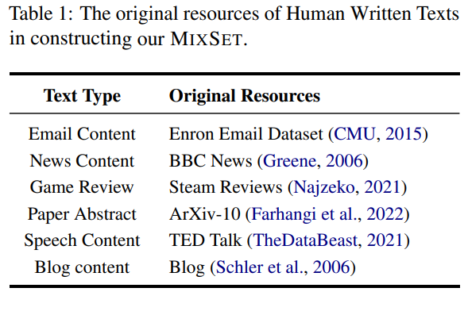
MixSet - ACL 2024
Five operations to generate mixtexts.
Two categories of operations:
AI-Revised Human Text
  Polish: Improve clarity and grammar at token/sentence level.
  Complete: AI finishes partially written human text (e.g., last 2/3).
  Rewrite: AI rewrites human text while preserving meaning.
Human-Revised AI Text
  Adapt: Humans modify AI text to sound more natural and fluent.
  Humanize: Introduce realistic human-like imperfections — typos, minor grammar errors, or links.

Slide 18
Why tailor the perfect prompt for polishing LinkedIn profiles
Prompts = control logic: The prompt determines how an LLM reasons, not just what it answers.
LLMs are highly prompt-sensitive: Minor wording changes can flip correctness, safety, and reasoning paths.
One prompt does not fit all inputs: Instance-specific clarification consistently outperforms generic task prompts.
Bad prompts cause hallucinations & unsafe behavior: Ambiguity → model fills gaps with guesses or harmful assumptions.
Fixing prompts beats fixing outputs: Prompting shapes the reasoning trajectory; post-hoc fixes cannot.

Slide 19
Ask Me Anything: A simple strategy for prompting language models
A method that boosts LLM accuracy without training by using multiple different prompt versions and combining their outputs.
How it works to create a better prompt:
Rephrase the task into a clear question.
The model rewrites the original input into a precise question the LLM can answer more reliably.
Generate many prompt variations.
It applies multiple “prompt-chains” (different question styles + different in-context examples) to create diverse versions of the prompt.
Collect multiple answers (“votes”). Each prompt variation produces its own answer.
Use weak supervision to pick the best one. (Snorkel-style)
An unsupervised label model estimates which prompt versions are most reliable and combines their answers into the final output.

Slide 20
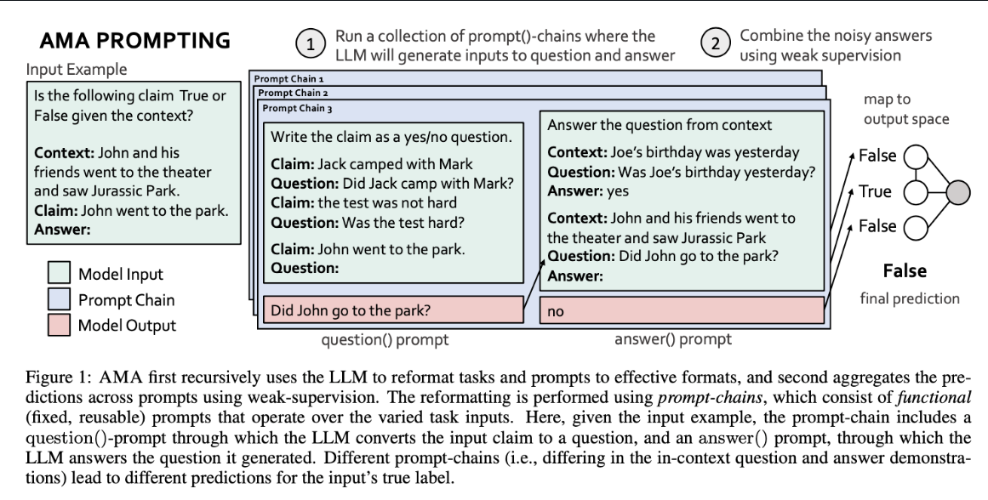
Ask Me Anything: A simple strategy for prompting language models

Slide 21
StablePrompt: Automatic Prompt Tuning using Reinforcement Learning for Large Language Models (ICLR 2024)
Composite heuristic score
Combine automatic metrics:
Writing quality → Lexical richness, readability metrics (Flesch–Kincaid, Dale–Chall)
Coherence → coherence classifier
Professional tone → sentiment + formality classifier
Fluency → perplexity
This becomes the reward function:
R = w₁readability + w₂professionalism + w₃*fluency − penalties
Use Reinforcement learning.

Slide 22
Self Refine: Iterative Refinement with Self-Feedback (NIPS 2023)
Generate multiple outputs from each candidate prompt.
Ask the LLM to critique them:
“Evaluate which output is most polished, concise, and recruiter-friendly. Explain why.”
Use the critiques to rewrite the prompt.
Repeat for 5–10 iterations.
https://arxiv.org/pdf/2303.17651
https://selfrefine.info/

Slide 23
Instances Need More Care: Rewriting Prompts for Instances with LLMs in the Loop Yields Better Zero-Shot Performance (ACL 2024)
Recent work like PROMPTED shows that a meta-LLM can improve your prompt on the fly.
Framework:
You supply:
“Here is my prompt. Here is the input text. Rewrite my prompt to optimize for clarity, professionalism, recruiter appeal.”
Meta-model outputs a better prompt.
You use that new prompt on the polishing model.

Slide 24
Overall Proposed Pipeline to generate GenuineGPT Profiles (LLM Refined)
Step 1: Pick an initial polishing instruction.
Step 2: Generate 5–20 variants of the seed prompt
Use: PROMPTED (meta rewriting), or simple manual rewrites
Step 3: Evaluate each using LLM-as-a-judge + heuristics
Ask a judge LLM:
“Rate this polished profile on clarity, professionalism, conciseness, impact, and recruiter appeal.”
Also compute: readability, fluency/perplexity
Step 4: Run evolutionary search or StablePrompt
Use the reward function (LLM-judge + heuristics) to pick the best prompts and mutate them.
Step 5: Pick the strongest final prompt

Slide 25
LLM Polishing Profile Prompts (hand-written)
I'll provide you with my current LinkedIn profile. Please modify it to make it more professional and make the keywords optimized better for searches. Constraints: Preserve factual accuracy - do not invent or add details beyond those provided. Do not exaggerate either. Keep it concise and keep the headings and subheadings the same.
I want to polish my linkedIn profile to be written to highlight leadership and volunteering roles and to clearly highlight the impact of every project I have undertaken. You can exaggerate in tone slightly but not in facts. Here is my profile, output in the same format as the input.
I want to modify my current linkedIn profile to appear as if I am a generalist and master of all trades. Without modifying any details or inventing new facts, maintain factual accuracy but modify my profile for this same purpose. You can modify the headings and subheadings too but do not make them very different from what is currently present.

Slide 26
LLM Polishing Profile Prompts (hand-written)
I want to make my linkedIn profile more ATS friendly, can you modify the content and the headings and subheadings from my profile, give the output in the same format as the input.
I want to modify my profile to make it sound more technical and like I have a lot of technical knowledge and expertise. Modify the given profile without inventing or adding any new details and give the output in the same format as the input.
Proofread my profile to check for any grammatical errors and improve the language wherever you can.

Slide 27
Future Work
Generate GenuineGPT profiles by utilising prompts on real LinkedIn profiles and LLMs, extending the current dataset to 4 classes
Develop a model for 4-way classification and compare with existing baselines (LLM DetectAive-main)

